Slide 1
Image Recognition Software for a Web App
By Heena Khan, James Phillips, Luis Chunga, Elijah Barbour, Mason Thieman, Matthew Radice, Steven Sheffey (Team ALCOVE)

Slide 2
Introduction
We developed a free food-finding app during HackMT where anybody can search for free food around them by entering their location
Also, users could donate their food by filling in information about the food type and quantity they are offering.
Previously, the food donor had to manually fill this information every time they hosted food, which became tedious.
Now, with our image recognition software, the food information is determined automatically, eliminating the form filling process.

Slide 3


Data
Our dataset is a 5GB dataset of food images with 101 food categories for different cuisine.
This dataset was used for the research paper “Food-101 -- Mining Discriminative Components with Random Forests" by Lukas Bossard [1]
Web scraping was used to collect more data

Slide 4

Methods: Mathematical Executions
The net input for a unit can be “folded” into a single value, net_{j} , which weights the activation of the sending neuron x_{i} by the strength of the synaptic connection between i and j, w_{ij} .
The sum of all weighted activations into a unit plus a bias weight, w0, is the total net input.
This is an example of a way that mathematics is an adequate measure in which neural networks can be represented

Slide 5
Methods: Mathematical Executions
Naturally, we learn more about an object or process by making incremental updates to the subject in our minds.
Since artificial neural networks mimic natural neural networks, we need a way to represent incremental changes within our artificial neural network.
Calculus is the mathematics of change, so the logical conclusion is to use Calculus to represent change within our artificial neural network.

Slide 6
Methods: Mathematical Executions
We used Rectified Linear Units (ReLU) as our activation function for a few of the hidden layers in our CNN, which can be represented by the equation.
ReLU was chosen as the activation function because of its simplicity in computation as opposed to others, which reduces training time.
Because our objective is to classify pictures, we also used softmax, an activation function commonly used for the classification of multiple tags.

Slide 7
Methods: Theoretical Execution
The inspiration for building and implementing artificial neural networks for Artificial Intelligence stems from biological foundations.
Knowing that this NN was influenced by natural brain processes, we can then look at the neurons roughly as an electrical processing system.
We are attempting to create a NN with tools such as Keras and TensorFlow that could train a model to recognize food images.

Slide 8
Methods: Practical Execution
In the first attempt, we developed a model using the pretrain model MobileNet as our simple base net.
On a small dataset, the accuracy was good, but when we implemented it with the entire dataset, it did not give us good results.
Then we tried a couple of MobileNet models such as MobileNetV2 and NASNetMobile.
The reason that we stick to a Mobile network is that it’s very resource consuming to train a whole massive Imagenet model.

Slide 9
Methods: Model Architecture
Our models accept an image of size 224 x 224 x 3 and output a probability vector of size N, where N is the number of classes the model is trained to consider.
Our primary model uses a pre-trained NASNetMobile model as its base.
We removed the final layers and added a max-pooling layer, a dense layer of varying size N, it is 101 for Model 1, 50 for Model 2 and 25 for Model 3, and a dropout layer with parameter 0.5.
We have not included NasNet architecture in our model summary because NasNet is a massive model with too many convolutional layers, maxpooling layers, and a dense layer.

Slide 10
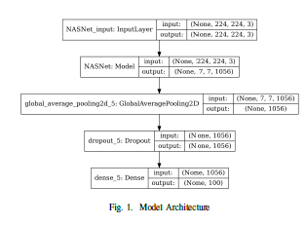
Methods: Model Architecture

Slide 11
Methods: Model Architecture
Modern image recognition can require heavy amounts of memory and processing power. Additionally, the training of these neural networks requires large amounts of data.
To solve this issue, for our models, we used Keras’s ImageDataGenerator.
This helps reduce the strain on the system from trying to load what could be thousands or hundreds of thousands of images all at once.
The data generator also provides methods for image pre-processing, such as resizing images, normalizing pixel values, and augmenting the dataset with transformations such as translation or rotation.

Slide 12
Methods: Model Architecture
In this research, we created three models. All three models had the same architecture mentioned above but different number of classes.
For each model, we randomly selected and trained on a certain number of food classes.
For each model, we have three different accuracies for top 1, top 5, and top 10 predictions.
We used the k-fold cross-validation to estimate our accuracy. For each model, we used an average of 5-fold.
For each fold, we randomly split the dataset into four parts for training and one part for testing. We used a 10% of our training dataset for validation.
After each k-fold is run, we evaluate and predict our model to compare the top 1, top 5, and top 10 accuracy.

Slide 13
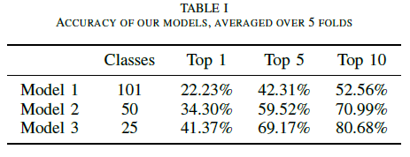
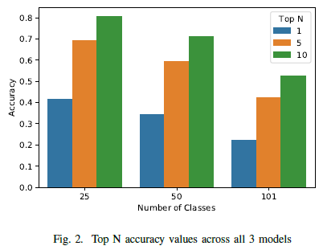
Results
Due to Model 1’s 22% accuracy as top 1, Models 2 and 3 had to be created.
Although Models 2 and 3 have a higher accuracy than Model 1, it was still not identifying most of the food images.
Since Model 1 could identify most of the images within the top 5 and 10, we deployed Model 1 into the Web app.

Slide 14
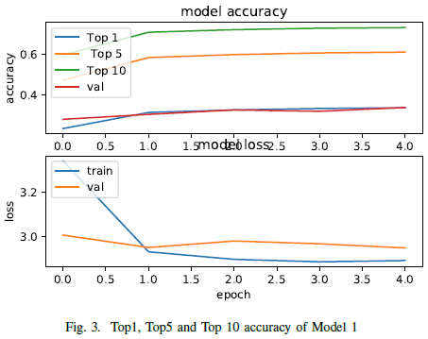
Results
Model 1 being trained on 101 classes has an accuracy of 0.2223 with f1 score of 0.3319.

Slide 15
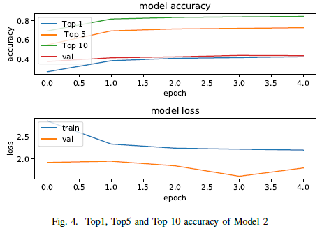
Results
Model 2 being trained on 50 random classes has an accuracy of 0.3430 with f1 score of 0.4322.

Slide 16
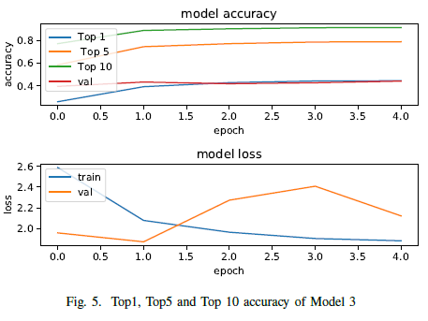
Results
Model 3 being trained on 25 random classes has an accuracy of 0.4137 with f1 score of 0.5203..

Slide 17
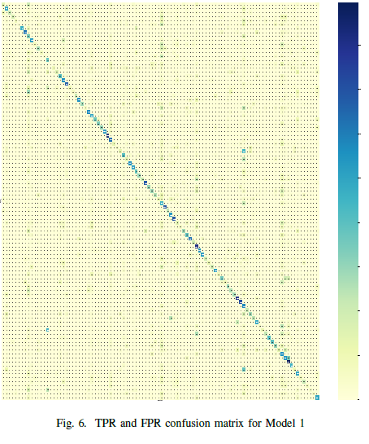
Results
We have generated a false-positive rate (FPR), true-positive rate (TPR) matrix, to identify our models precision.
The diagonal represents (predicted label = actual label) where we want our maximum count to be.
In Figure 6, We have a light diagonal, that represents our true-positive. Also, we can see there are several false-positives throughout our matrix.

Slide 18
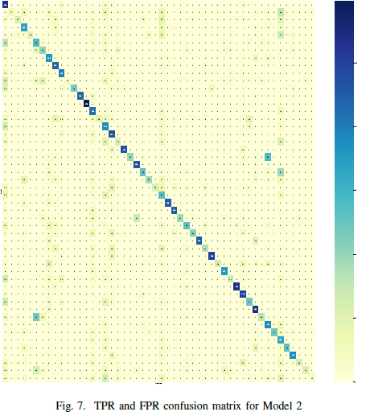
Results
In Figure 7, We have a slightly darker diagonal, that represents our true-positive.
We can see that some classes were identified better than the other.
Also, there is some improvement in our misclassifications/false-positives rate

Slide 19
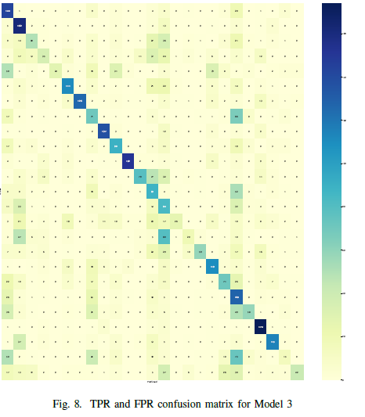
Results
On the basis of accuracy Model 3 is our most efficient model..
In Figure 8, We have a darker diagonal, that represents our true-positive.
We can see that half of the classes were identified better than the other half. Also, there is some improvement in our misclassifications/false-positives rate.

Slide 20
Conclusion
Overall, this project set out to train a network capable of classifying a food item that a user would like to donate, alleviating some tedious aspects of the donation process.
With the results that were achieved, our team feels strongly that we have accomplished this goal.

Slide 21
References
[1] Z. Dou, J. D. Ferguson, D. T. Galligan, A. M. Kelly, S. M. Finn, and R. Giegengack, “Assessing us food wastage and opportunities for reduction,” Global Food Security, vol. 8, pp. 19–26, 2016.
[2] L. Bossard, M. Guillaumin, and L. Van Gool, “Food-101–mining discriminative components with random forests,” in European conference on computer vision. Springer, 2014, pp. 446–461.
[3] S. Mader, “Food images (food-101),” May 2018. [Online]. Available: https://www.kaggle.com/kmader/food41
[4] Y. Zhu, Y. Chen, Z. Lu, S. J. Pan, G.-R. Xue, Y. Yu, and Q. Yang, “Heterogeneous transfer learning for image classification,” in Twenty-Fifth AAAI Conference on Artificial Intelligence, 2011.

Slide 22
References
[5] P. Asikanius, “Predicting image social tags using a convolutional neural network,” Master’s thesis, 2018.
[6] J. Deng, W. Dong, R. Socher, L. Li, Kai Li, and Li Fei-Fei, “Imagenet: A large-scale hierarchical image database,” in 2009 IEEE Conference on Computer Vision and Pattern Recognition, 2009, pp. 248–255.
[7] “Dagnetwork.” [Online]. Available: https://www.mathworks.com/help/deeplearning/ref/nasnetmobile.html
[8]B. Zoph, V. Vasudevan, J. Shlens, and Q. V. Le, “Learning transferable architectures for scalable image recognition,” 2017.

